Slide 1


CS3601 · 操作系统（2025秋）
同步原语的实现
董明凯
IPADS · 上海交通大学

Slide 2
版权声明
本内容版权归上海交通大学并行与分布式系统研究所所有
使用者可以将全部或部分本内容免费用于非商业用途
使用者在使用全部或部分本内容时请注明来源
内容来自：上海交通大学并行与分布式系统研究所+材料名字
对于不遵守此声明或者其他违法使用本内容者，将依法保留追究权
本内容的发布采用 Creative Commons Attribution 4.0 License
完整文本：https://creativecommons.org/licenses/by/4.0/legalcode

Slide 3
回顾：使用互斥锁解决临界区问题
如何确保他们不会将新产生的数据放入到同一个缓冲区中，造成数据覆盖？
拿钥匙：lock
还钥匙：unlock
Notes:
为了解决解决竞争冒险

Slide 4
回顾：解决临界区问题的三个要求
互斥访问：在同一时刻，有且仅有一个线程可以进入临界区
有限等待：当一个线程申请进入临界区之后，必须在有限的时间内获得许可进入临界区而不能无限等待
空闲让进：当没有线程在临界区中时，必须在申请进入临界区的线程中选择一个进入临界区，保证执行临界区的进展
Notes:
为了解决解决竞争冒险

Slide 5
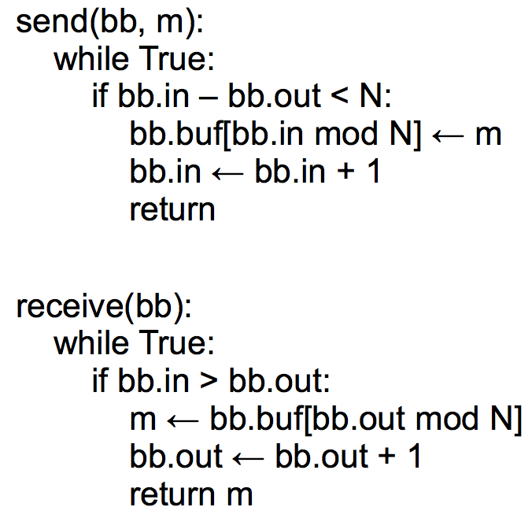
生产者 (sender) & 消费者 (receiver)
在单生产者单消费者场景下，不需要Lock
out=2
in=5

Slide 6
使用lock保护生产者的两种实现
send(bb, message):
lock(bb.send_lock)
while True:
if bb.in – bb.out < N:
bb.buf[bb.in mod N] <- message
bb.in <- bb.in + 1
unlock(bb.send_lock)
return
send(bb, message):
while True:
lock(bb.send_lock)
if bb.in – bb.out < N:
bb.buf[bb.in mod N] <- message
bb.in <- bb.in + 1
unlock(bb.send_lock)
return
unlock(bb.send_lock)
实现-1：缺点：拿着锁轮询
注意：bb.send_lock只保护send
实现-2：不断放锁再拿锁

Slide 7
Lock：一种直观但错误的实现
struct lock { integer state; };
void lock (lock reference L) {
while L.state == LOCKED
; // spin until L is UNLOCKED
L.state = LOCKED; // the while test failed, got the lock
}
void unlock (lock reference L) {
L.state = UNLOCKED;
}

Slide 8
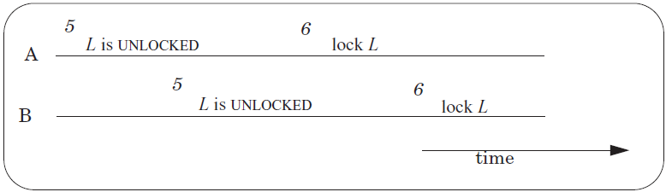
竞争条件依然存在！
A 和 B 同时拿到了锁!
读L
写L
读L
写L
操作-1: 读L，检查状态是否为Locked
操作-2: 写L，将其状态设置为Locked
这两步并非原子完成！
需要用另一个lock来保证原子性？
Notes:
How do you handle this in Lab-1?

Slide 9
互斥锁实现：基于硬件原子指令

Slide 10
回到Lock的naive实现
A 和 B 同时拿到了锁!
读L
写L
读L
写L
操作-1: 读L，检查状态是否为Locked
操作-2: 写L，将其状态设置为Locked
根本原因：这两步并非原子完成！
硬件方法：用原子指令来保证两步是原子的！
Notes:
How do you handle this in Lab-1?

Slide 11
新指令-1：Test-and-Set
历史
1960年代初期，Burroughs B5000首先引入
1 int TestAndSet(int *old_ptr, int new) {
2 int old = *old_ptr; // fetch old value at old_ptr
3 *old_ptr = new; // store 'new' into old_ptr
4 return old; // return the old value
5 }

Slide 12
使用 Test-and-Set 实现 Spin Lock
1 typedef struct __lock_t {
2 int flag;
3 } lock_t;
4
5 void init(lock_t *lock) {
6 // 0 indicates that lock is available, 1 that it is held
7 lock->flag = 0;
8 }
9
10 void lock(lock_t *lock) {
11 while (TestAndSet(&lock->flag, 1) == 1)
12 ; // spin-wait (do nothing)
13 }
14
15 void unlock(lock_t *lock) {
16 lock->flag = 0;
17 }

Slide 13
新指令-2：Compare-and-swap
另一个原子的硬件原语
Compare-and-swap (on SPARC)
Compare-and-exchange (on x86)
1 int CompareAndSwap(int *ptr, int expected, int new) {
2 int actual = *ptr;
3 if (actual == expected)
4 *ptr = new;
5 return actual;
6 }

Slide 14
用 Compare-and-swap 实现 Spin Lock
1 typedef struct __lock_t {
2 int flag;
3 } lock_t;
4
5 void init(lock_t *lock) {
6 // 0 indicates that lock is available, 1 that it is held
7 lock->flag = 0;
8 }
9
10 void lock(lock_t *lock) {
11 while (CompareAndSwap(&lock->flag, 0, 1) == 1)
12 ; // spin-wait (do nothing)
13 }
14
15 void unlock(lock_t *lock) {
16 lock->flag = 0;
17 }

Slide 15
ARM新指令-3：Load-linked & Store-conditional
1 int LoadLinked(int *ptr) { 2 return *ptr; 3 } 4 5 int StoreConditional(int *ptr, int value) { 6 if (no one has updated *ptr since the LoadLinked to this address) { 7 *ptr = value; 8 return 1; // success! 9 } else { 10 return 0; // failed to update 11 } 12 }

Slide 16
用 LL/SC 来实现 Spinlock
1 void lock(lock_t *lock) {
2 while (1) {
3 while (LoadLinked(&lock->flag) == 1)
4 ; // spin until it's zero
5 if (StoreConditional(&lock->flag, 1) == 1)
6 return; // if set-it-to-1 was a success: all done
7 // otherwise: try it all over again
8 }
9 }
10
11 void unlock(lock_t *lock) {
12 lock->flag = 0;
13 }

Slide 17
新指令-4：Fetch-and-add
1 int FetchAndAdd(int *ptr) {
2 int old = *ptr;
3 *ptr = old + 1;
4 return old;
5 }

Slide 18

用 Fetch-and-add 实现 Ticket Lock
1 typedef struct __lock_t {
2 int ticket;
3 int turn;
4 } lock_t;
5
6 void lock_init(lock_t *lock) {
7 lock->ticket = 0;
8 lock->turn = 0;
9 }
10
11 void lock(lock_t *lock) {
12 int myturn = FetchAndAdd(&lock->ticket);
13 while (lock->turn != myturn)
14 ; // spin
15 }
16
17 void unlock(lock_t *lock) {
18 lock->turn = lock->turn + 1;
19 }
和Spin Lock相比，Ticket Lock具有一些新特性

Slide 19
排号锁（Ticket Lock）
思考：我们如何保证竞争者的公平性？

Slide 20



排号锁（Ticket Lock）
思考：我们如何保证竞争者的公平性？
通过遵循竞争者到达的顺序来传递锁。
owner：表示当前在吃的食客 next：表示目前放号的最新值
3
4
5
2.等待叫号
while(owner != my_ticket);
假设只有一桌...
owner = 3
next = 6
拿号 => 6号
my_ticket = atmoic_FAA(&next, 1)

Slide 21
排号锁（Ticket Lock）
思考：我们如何保证竞争者的公平性？
通过遵循竞争者到达的顺序来传递锁。
owner：表示当前在吃的食客 next：表示目前放号的最新值
while(owner != my_ticket);
3
4
5
6
假设只有一桌...
2. 叫下个人进来
owner += 1
吃完了，买单
owner = 3
next = 7

Slide 22
排号锁（Ticket Lock）
思考：我们如何保证竞争者的公平性？
通过遵循竞争者到达的顺序来传递锁。
owner：表示当前的持有者 next：表示目前放号的最新值
lock操作
unlock操作
my_ticket = atomic_FAA( &lock->next, 1);
while(lock->owner != my_ticket)
/* waiting */;
lock->owner ++;

Slide 23
条件变量的实现

Slide 24
回顾：条件变量
之前互斥锁的实现中：
while(something)
/* busy waiting */;
条件变量：提供睡眠/唤醒机制，避免无意义的等待。
线程-0
线程-1
if(!some_condition)
wait(condition, lock);
update(some_condition);
signal(condition);
Wake up and check condition again

Slide 25
回顾：条件变量的两个接口
等待的接口：
等待需要在临界区中
void wait(struct cond *cond, struct lock *mutex);
放入条件变量的等待队列
阻塞自己同时释放锁
被唤醒后重新获取锁
如何阻塞自己的线程？通过yield()系统调用
唤醒的接口：
void signal(struct cond *cond);
检查等待队列
如果有等待者则移出等待队列并唤醒

Slide 26
条件变量的实现（语义级）
等待的接口：
需要操作系统辅助实现
void wait(struct cond *cond, struct lock *mutex);
放入条件变量的等待队列
阻塞自己同时释放锁
被唤醒后重新获取锁
list_append(cond->wait_list, proc_self());
unlock(mutex), yield() 注意这两步是原子的
lock(mutex);
唤醒的接口：
void signal(struct cond *cond);
检查等待队列
如果有等待者则移出等待队列并唤醒
if (!list_empty(cond->wait_list))
wakeup(list_remove(cond->wait_list));

Slide 27
条件变量的基础：YIELD()

Slide 28
系统调用：yield()
进程调用yield()，主动放弃CPU，进入可运行队列等待，类似sleep
yield()的具体步骤:
暂停当前运行的线程: 保存上下文
选择新的可运行线程: 例如通过round-robin找到下一个RUNNABLE线程
恢复上一步所选线程: 重新加载该线程的状态
三个数据结构
threads table：记录所有线程的表
t_lock：即 threads table lock，用于保护 threads table
CPUs table：记录每个CPU当前运行线程（注意这个表没有用lock保护）
Notes:
因为每个cpu table只会被当前CPU访问，所以不会出现并发访问的情况

Slide 29
使用yield实现send？
注意：这里的send()是正确的，但 并非最终版本，仅用于展示yield()
send(bb, msg):
lock(bb.lock)
while True:
if bb.in – bb.out < N:
bb.buf[bb.in mod N] <- msg
bb.in <- bb.in + 1
unlock(bb.lock)
return
send(bb, msg):
lock(bb.lock)
while True:
if bb.in - bb.out < N:
bb.buf[bb.in mod N] <- msg
bb.in <- bb.in + 1
unlock(bb.lock)
return
unlock(bb.lock)
yield()
lock(bb.lock)
新加三行
之前：使用lock来保护临界区
缺点：CPU busy loop，浪费资源
之后：若不满足条件则主动调yield放弃CPU
缺点：线程下次运行时，可能还是不满足条件，依然浪费CPU资源

Slide 30
YIELD() 实现
yield():
// Suspend the running thread
// Choose a new thread
// Resume the new thread

Slide 31
YIELD() 实现
yield():
lock(t_lock)
id = id of current thread
threads[id].state = RUNNABLE
threads[id].sp = SP
// Choose a new thread
// Resume the new thread
unlock(t_lock)
暂停运行的线程
threads
记录所有线程的表（整个系统只用这一张表）
t_lock
用于保护 thread table 的锁

Slide 32
YIELD() 实现
yield():
lock(t_lock)
id = cpus[CPU].thread
threads[id].state = RUNNABLE
threads[id].sp = SP
// Choose a new thread
// Resume the new thread
unlock(t_lock)
暂停运行的线程
cpus
表：包含所有CPU当前运行的thread ID
问题: 为什么不需要用一个锁来保护？

Slide 33
YIELD() 实现
yield():
lock(t_lock)
id = cpus[CPU].thread
threads[id].state = RUNNABLE
threads[id].sp = SP
do:
id = (id + 1) mod N
while threads[id].state != RUNNABLE
// Resume new thread
unlock(t_lock)
暂停运行的线程
选择新线程
目前，线程可能的状态：RUNNING, RUNNABLE (后面还会有WAITING)

Slide 34
YIELD() 实现
yield():
lock(t_lock)
id = cpus[CPU].thread
threads[id].state = RUNNABLE
threads[id].sp = SP
do:
id = (id + 1) mod N
while threads[id].state != RUNNABLE
SP = threads[id].sp
threads[id].state = RUNNING
cpus[CPU].thread = id
unlock(t_lock)
暂停运行的线程
选择新线程
恢复新线程运行
t_lock
原子性地设置 threads[ ].state 和 .sp
原子性地找到一个 RUNNABLE 的线程，并改为RUNNING

Slide 35
没有 t_lock 会咋样？
选到同一个 thread 去执行！
选到一个还没把 SP 存好的 thread 去执行！
CPU Core 0
yield():
id = cpus[CPU].thread
threads[id].state = RUNNABLE
threads[id].sp = SP
do:
id = (id + 1) mod N
while threads[id].state != RUNNABLE
SP = threads[id].sp
threads[id].state = RUNNING
cpus[CPU].thread = id
CPU Core 1
yield():
id = cpus[CPU].thread
threads[id].state = RUNNABLE
threads[id].sp = SP
do:
id = (id + 1) mod N
while threads[id].state != RUNNABLE
SP = threads[id].sp
threads[id].state = RUNNING
cpus[CPU].thread = id

Slide 36
没有 t_lock 会咋样？
选到同一个 thread 去执行！
选到一个还没把 SP 存好的 thread 去执行！
CPU Core 0
yield():
id = cpus[CPU].thread
threads[id].state = RUNNABLE
threads[id].sp = SP
do:
id = (id + 1) mod N
while threads[id].state != RUNNABLE
SP = threads[id].sp
threads[id].state = RUNNING
cpus[CPU].thread = id
CPU Core 1
yield():
id = cpus[CPU].thread
threads[id].state = RUNNABLE
threads[id].sp = SP
do:
id = (id + 1) mod N
while threads[id].state != RUNNABLE
SP = threads[id].sp
threads[id].state = RUNNING
cpus[CPU].thread = id
Lock1保护
Lock2保护
Lock1保护
这样对吗？
Notes:
不对，lock2 保护不到

Slide 37
没有 t_lock 会咋样？
选到同一个 thread 去执行！
选到一个还没把 SP 存好的 thread 去执行！
CPU Core 0
yield():
id = cpus[CPU].thread
threads[id].state = RUNNABLE
threads[id].sp = SP
do:
id = (id + 1) mod N
while threads[id].state != RUNNABLE
SP = threads[id].sp
threads[id].state = RUNNING
cpus[CPU].thread = id
CPU Core 1
yield():
id = cpus[CPU].thread
threads[id].state = RUNNABLE
threads[id].sp = SP
do:
id = (id + 1) mod N
while threads[id].state != RUNNABLE
SP = threads[id].sp
threads[id].state = RUNNING
cpus[CPU].thread = id
Lock1保护
Lock1保护
这样对吗？
Notes:
对，但是没必要 unlock 之后马上 lock

Slide 38
没有 t_lock 会咋样？
选到同一个 thread 去执行！
选到一个还没把 SP 存好的 thread 去执行！
CPU Core 0
yield():
id = cpus[CPU].thread
threads[id].state = RUNNABLE
threads[id].sp = SP
do:
id = (id + 1) mod N
while threads[id].state != RUNNABLE
SP = threads[id].sp
threads[id].state = RUNNING
cpus[CPU].thread = id
CPU Core 1
yield():
id = cpus[CPU].thread
threads[id].state = RUNNABLE
threads[id].sp = SP
do:
id = (id + 1) mod N
while threads[id].state != RUNNABLE
SP = threads[id].sp
threads[id].state = RUNNING
cpus[CPU].thread = id
Lock1保护
这样对吗？
Notes:
不对，lock2 保护不到

Slide 39
条件变量的实现：wait & Signal

Slide 40
使用 WAIT/SIGNAL 实现send：直观但错误
send(bb, msg):
lock(bb.lock)
while True:
if bb.in - bb.out < N:
bb.buf[bb.in mod N] <- msg
bb.in <- bb.in + 1
unlock(bb.lock)
return
unlock(bb.lock)
yield()
lock(bb.lock)
send(bb, msg):
lock(bb.lock)
while True:
if bb.in - bb.out < N:
bb.buf[bb.in mod N] <- msg
bb.in <- bb.in + 1
unlock(bb.lock)
signal(bb.not_empty)
return
unlock(bb.lock)
wait(bb.not_full)
lock(bb.lock)
wait() 会调用 yield()
使用yield的send版本（依然浪费CPU）
再次注意：这里的wait接口是错的，没有把bb.lock放进去，先看看会怎么错

Slide 41
使用 WAIT/SIGNAL 实现send：直观但错误
send(bb, msg):
lock(bb.lock)
while True:
if bb.in - bb.out < N:
bb.buf[bb.in mod N] <- msg
bb.in <- bb.in + 1
unlock(bb.lock)
signal(bb.not_empty)
return
unlock(bb.lock)
wait(bb.not_full)
lock(bb.lock)
send(bb, msg):
lock(bb.lock)
while True:
if bb.in - bb.out < N: break;
unlock(bb.lock)
wait(bb.not_full)
lock(bb.lock)
bb.buf[bb.in mod N] <- msg
bb.in <- bb.in + 1
unlock(bb.lock)
signal(bb.not_empty)
return
改写一下
更清楚
wait() 会调用 yield()
再次注意：这里的wait接口是错的，没有把bb.lock放进去，先看看会怎么错

Slide 42
使用 WAIT/SIGNAL 实现send：直观但错误
send(bb, msg):
lock(bb.lock)
while True:
if bb.in - bb.out < N: break;
unlock(bb.lock)
wait(bb.not_full)
lock(bb.lock)
bb.buf[bb.in mod N] <- msg
bb.in <- bb.in + 1
unlock(bb.lock)
signal(bb.not_empty)
return
receive(bb, msg):
lock(bb.lock)
while True:
if bb.in > bb.out: break;
unlock(bb.lock)
wait(bb.not_empty)
lock(bb.lock)
msg <- bb.buf[bb.out mod N]
bb.out <- bb.out + 1
unlock(bb.lock)
signal(bb.not_full)
return
Core 1
wait() 会调用 yield()
Core 2
会有什么问题？
再次注意：这里的wait接口是错的，没有把bb.lock放进去，先看看会怎么错

Slide 43
使用 WAIT/SIGNAL 实现send：直观但错误
send(bb, msg):
lock(bb.lock)
while True:
if bb.in - bb.out < N: break;
unlock(bb.lock)
wait(bb.not_full)
lock(bb.lock)
bb.buf[bb.in mod N] <- msg
bb.in <- bb.in + 1
signal(bb.not_empty)
unlock(bb.lock)
return
receive(bb, msg):
lock(bb.lock)
while True:
if bb.in > bb.out: break;
unlock(bb.lock)
wait(bb.not_empty)
lock(bb.lock)
msg <- bb.buf[bb.out mod N]
bb.out <- bb.out + 1
signal(bb.not_full)
unlock(bb.lock)
return
Core 1
wait() 会调用 yield()
Core 2
这样呢？
依然不对，核心原因是在 unlock 和 wait 之间可能会插入 receive 中的 signal 操作
所以不能给 unlock+wait 要一起完成，不给 receive 可乘之机！

Slide 44
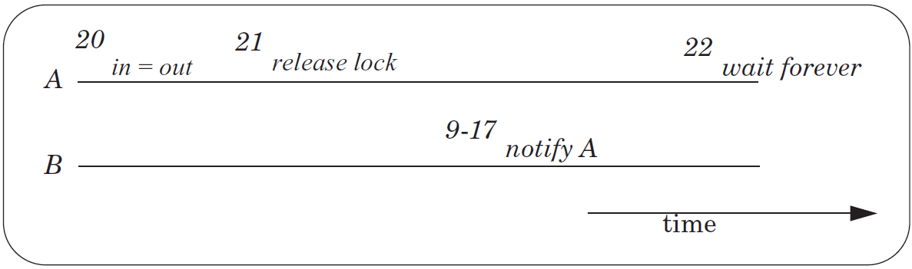
Lost Notification 问题
即signal

Slide 45
带锁参数的API: WAIT(bb.full, bb.lock)
send(bb, msg):
lock(bb.lock)
while True:
if bb.in - bb.out < N: break
unlock(bb.lock)
wait(bb.not_full)
lock(bb.lock)
bb.buf[bb.in mod N] <- msg
bb.in <- bb.in + 1
unlock(bb.lock)
signal(bb.not_empty)
return
send(bb, msg):
lock(bb.lock)
while True:
if bb.in - bb.out < N: break
unlock(bb.lock)
wait(bb.not_full)
lock(bb.lock)
wait(bb.not_full, bb.lock)
bb.buf[bb.in mod N] <- msg
bb.in <- bb.in + 1
unlock(bb.lock)
signal(bb.not_empty)
return

Slide 46
WAIT & SIGNAL
使用 t_lock 来保证放lock和yield的原子性
注意：t_lock 和 lock 的顺序很重要
如果先放 unlock(lock)，会怎么样？
send(bb, msg):
lock(bb.lock)
while True:
if bb.in - bb.out < N: break
wait(bb.not_full, bb.lock)
bb.buf[bb.in mod N] <- msg
bb.in <- bb.in + 1
unlock(bb.lock)
signal(bb.not_empty)
return
wait(cv, lock):
lock(t_lock)
unlock(lock)
threads[id].cv = cv
threads[id].state = WAITING
yield_wait()
unlock(t_lock)
lock(lock)
Not yield()
signal(cv):
lock(t_lock)
for I = 0 to N-1:
if threads[i].cv == cv &&
threads[i].state == WAITING:
threads[i].state = RUNNABLE
unlock(t_lock)
receive(bb, msg):
lock(bb.lock)
...
unlock(bb.lock)
signal(bb.not_full)
Notes:
t_lock是用来保证lock和yield是原子的

Slide 47
WAIT & SIGNAL
wait(cv, lock):
lock(t_lock)
unlock(lock)
threads[id].cv = cv
threads[id].state = WAITING
yield_wait()
unlock(t_lock)
lock(lock)
signal(cv):
lock(t_lock)
for I = 0 to N-1:
if threads[i].cv == cv && threads[i].state == WAITING:
threads[i].state = RUNNABLE
unlock(t_lock)

Slide 48
回顾下YIELD的实现
yield():
lock(t_lock)
id = cpus[CPU].thread
threads[id].state = RUNNABLE
threads[id].sp = SP
do:
id = (id + 1) mod N
while threads[id].state != RUNNABLE
SP = threads[id].sp
threads[id].state = RUNNING
cpus[CPU].thread = id
unlock(t_lock)
暂停运行线程
找到新线程
恢复新线程运行

Slide 49
YIELD_WAIT()
yield_wait(): // called by wait()
lock(t_lock)
id = cpus[CPU].thread
threads[id].state = RUNNABLE
threads[id].sp = SP
do:
id = (id + 1) mod N
while threads[id].state != RUNNABLE
SP = threads[id].sp
threads[id].state = RUNNING
cpus[CPU].thread = id
unlock(t_lock)
wait(cv, lock):
lock(t_lock)
unlock(lock)
threads[id].cv = cv
threads[id].state = WAITING
yield_wait()
unlock(t_lock)
lock(lock)
t_lock 已经被 wait() 拿到，不需要再拿
当前线程已被设为WAITING，不再设为 RUNNABLE

Slide 50
YIELD_WAIT()
yield_wait(): // called by wait()
id = cpus[CPU].thread
threads[id].sp = SP
do:
id = (id + 1) mod N
while threads[id].state != RUNNABLE
SP = threads[id].sp
threads[id].state = RUNNING
cpus[CPU].thread = id
可能永远在循环！
wait(cv, lock):
lock(t_lock)
unlock(lock)
threads[id].cv = cv
threads[id].state = WAITING
yield_wait()
unlock(t_lock)
lock(lock)
问题: 如果当前threads[]中没有一个 RUNNABLE 的线程，会怎么样？
yield_wait()将一直在循环中，而且拿着 t_lock！
除非其他CPU运行signal，将某些线程唤醒，状态设置为RUNNABLE
但运行 signal 需要拿到 t_lock，而拿着 t_lock的CPU正在循环中! => deadlock!

Slide 51
YIELD_WAIT()
yield_wait(): // called by wait()
id = cpus[CPU].thread
threads[id].sp = SP
do:
id = (id + 1) mod N
unlock(t_lock)
lock(t_lock)
while threads[id].state != RUNNABLE
SP = threads[id].sp
threads[id].state = RUNNING
cpus[CPU].thread = id
wait(cv, lock):
lock(t_lock)
unlock(lock)
threads[id].cv = cv
threads[id].state = WAITING
yield_wait()
unlock(t_lock)
lock(lock)
问题: 一旦 yield_wait() 释放 t_lock, 另一个 CPU 可能立刻运行当前线程，导致2个CPU的SP会同时指向当前线程，于是栈被破坏！
一种可能的时间线：线程-0在CPU-0上运行wait，正在箭头处 → CPU-1上的线程-1运行signal，将线程-0的状态恢复成RUNNABLE → CPU-2上的thread-2调用了wait，找到了RUNNABLE的线程-0，并开始运行 → 此时CPU-0和CPU-2的SP都指向了线程-0的栈！
Notes:
SP currently points to the original thread's stack -- call it thread A.
Between release and acquire, another CPU could run thread A. This
means that two CPUs will have their stack pointer pointing to thread
A's stack. This is a very easy way for A's stack to get corrupted.

Slide 52
YIELD_WAIT()
yield_wait(): // called by wait()
id = cpus[CPU].thread
threads[id].sp = SP
SP = cpus[CPU].stack
do:
id = (id + 1) mod N
unlock(t_lock)
lock(t_lock)
while threads[id].state != RUNNABLE
SP = threads[id].sp
threads[id].state = RUNNING
cpus[CPU].thread = id
wait(cv, lock):
lock(t_lock)
unlock(lock)
threads[id].cv = cv
threads[id].state = WAITING
yield_wait()
unlock(t_lock)
lock(lock)
改进：为每个CPU专门设一个栈，记录在cpus表中
这个栈不会共享（每个CPU独占），不用担心多个CPU的SP同时指向这个栈
这只是一个临时的栈，马上SP就会指向新线程的栈

Slide 53
时钟中断处理函数
yield():
lock(t_lock)
id = cpus[CPU].thread
threads[id].state = RUNNABLE
threads[id].sp = SP
do:
id = (id + 1) mod N
while threads[id].state != RUNNABLE
SP = threads[id].sp
threads[id].state = RUNNING
cpus[CPU].thread = id
unlock(t_lock)
timer_interrupt():
push PC
push registers
yield()
pop registers
pop PC

Slide 54
YIELD_WAIT()
yield_wait(): // called by wait()
id = cpus[CPU].thread
threads[id].sp = SP
SP = cpus[CPU].stack
do:
id = (id + 1) mod N
unlock(t_lock)
lock(t_lock)
while threads[id].state != RUNNABLE
SP = threads[id].sp
threads[id].state = RUNNING
cpus[CPU].thread = id
wait(cv, lock):
lock(t_lock)
unlock(lock)
threads[id].cv = cv
threads[id].state = WAITING
yield_wait()
unlock(t_lock)
lock(lock)
yield():
lock(t_lock)
id = cpus[CPU].thread
threads[id].state = RUNNABLE
threads[id].sp = SP
do:
id = (id + 1) mod N
while threads[id].state != RUNNABLE
SP = threads[id].sp
threads[id].state = RUNNING
cpus[CPU].thread = id
unlock(t_lock)
问题: 如果CPU正在运行yield / yield_wait 的时候，发生了时钟中断，怎么办？
因为 t_lock 已经被当前CPU拿到了，当发生时钟中断后，其handler调用 yield()时会再次尝试拿 t_lock，从而自己等自己！

Slide 55
YIELD_WAIT()
yield_wait(): // called by wait()
id = cpus[CPU].thread
threads[id].sp = SP
SP = cpus[CPU].stack
do:
id = (id + 1) mod N
unlock(t_lock)
enable_interrupt()
disable_interrupt()
lock(t_lock)
while threads[id].state != RUNNABLE
SP = threads[id].sp
threads[id].state = RUNNING
cpus[CPU].thread = id
wait(cv, lock):
disable_interrupt()
lock(t_lock)
unlock(lock)
threads[id].cv = cv
threads[id].state = WAITING
yield_wait()
unlock(t_lock)
enable_interrupt()
lock(lock)
yield()
yield():
lock(t_lock)
id = cpus[CPU].thread
threads[id].state = RUNNABLE
threads[id].sp = SP
do:
id = (id + 1) mod N
while threads[id].state != RUNNABLE
SP = threads[id].sp
threads[id].state = RUNNING
cpus[CPU].thread = id
unlock(t_lock)
Notes:
remember the yield(), which will change threads[id] to RUNNABLE. conflict!
should also change yield().

Slide 56
YIELD_WAIT()
yield_wait(): // called by wait()
id = cpus[CPU].thread
threads[id].sp = SP
SP = cpus[CPU].stack
do:
id = (id + 1) mod N
unlock(t_lock)
enable_interrupt()
disable_interrupt()
lock(t_lock)
while threads[id].state != RUNNABLE
SP = threads[id].sp
threads[id].state = RUNNING
cpus[CPU].thread = id
yield():
lock(t_lock)
id = cpus[CPU].thread
threads[id].state = RUNNABLE
threads[id].sp = SP
do:
id = (id + 1) mod N
while threads[id].state != RUNNABLE
SP = threads[id].sp
threads[id].state = RUNNING
cpus[CPU].thread = id
unlock(t_lock)
wait(cv, lock):
disable_interrupt()
lock(t_lock)
unlock(lock)
threads[id].cv = cv
threads[id].state = WAITING
yield_wait()
unlock(t_lock)
enable_interrupt()
lock(lock)
yield()
新问题: 如果时钟中断来了，会导致错误的thread去sleep！
Notes:
remember the yield(), which will change threads[id] to RUNNABLE. conflict!
should also change yield().

Slide 57
YIELD_WAIT()
yield_wait(): // called by wait()
id = cpus[CPU].thread
cpus[CPU].thread = null
threads[id].sp = SP
SP = cpus[CPU].stack
do:
id = (id + 1) mod N
unlock(t_lock)
enable_interrupt()
disable_interrupt()
lock(t_lock)
while threads[id].state != RUNNABLE
SP = threads[id].sp
threads[id].state = RUNNING
cpus[CPU].thread = id
wait(cv, lock):
disable_interrupt()
lock(t_lock)
unlock(lock)
threads[id].cv = cv
threads[id].state = WAITING
yield_wait()
unlock(t_lock)
enable_interrupt()
lock(lock)

Slide 58
时钟中断处理函数
yield():
lock(t_lock)
id = cpus[CPU].thread
if (thread == null) return
threads[id].state = RUNNABLE
threads[id].sp = SP
do:
id = (id + 1) mod N
while threads[id].state != RUNNABLE
SP = threads[id].sp
threads[id].state = RUNNING
cpus[CPU].thread = id
unlock(t_lock)
timer_interrupt():
push PC
push registers
yield()
pop registers
pop PC

Slide 59
信号量的实现

Slide 60
回顾：生产者消费者问题的另一种实现
生产者：
使用 互斥锁 搭配 条件变量 完成资源的等待与消耗
while(true) {
new_msg = produce_new();
lock(&empty_slot_lock);
while (empty_slot == 0)
cond_wait(&empty_cond, &empty_slot_lock);
empty_slot--;
unlock(&empty_slot_lock);
buffer_add(new_msg);
// ...
}
当前实现：需要单独创建互斥锁与条件变量，并手动通过计数器来管理资源数量
为何不提出新的同步原语，便于在多个线程之间管理资源
Notes:
为了介绍信号量，先介绍生产者消费者问题的另一种实现

Slide 61
信号量的使用
while(true) {
new_msg = produce_new();
lock(&empty_slot_lock);
while (empty_slot == 0)
cond_wait(&empty_cond,
&empty_slot_lock);
empty_slot --;
unlock(&empty_slot_lock);
buffer_add(new_msg);
// ...
}
使用信号量可以将其压缩到一行代码
void producer(void) {
new_msg = produce_new(); sem_wait(&empty_slot_sem);
buffer_add(new_msg);
// ...
}
消耗empty_slot
Notes:
本章开头的两个例子

Slide 62
信号量的使用
为什么信号量没有lost notification的问题呢？因为counter会记录下notification
void producer(void) {
new_msg = produce_new(); sem_wait(&empty_slot_sem);
buffer_add(new_msg); sem_signal(&filled_slot_sem);
}
消耗empty_slot
增加filled_slot
void consumer(void) {
sem_wait(&filled_slot_sem);
cur_msg = buffer_remove(); sem_signal(&empty_slot_sem); handle_msg(cur_msg);
}
消耗filled_slot
增加empty_slot
Notes:
本章开头的两个例子

Slide 63
回顾：信号量的基本语义
通过计数器来协调（阻塞/放行）多个线程的执行。
语义上：
P操作
void wait(int S) {
while(S <= 0)
/* Waiting */;
S--;
}
void signal(int S) {
S++;
}
V操作
这样实现是否会有问题？为什么？

Slide 64
回顾：信号量的基本语义
通过计数器来协调（阻塞/放行）多个线程的执行。
语义上：
P操作
void wait(int S) {
while(S <= 0)
/* Waiting */;
atomic_add(&S, -1);
}
void signal(int S) {
atomic_add(&S, 1);
}
V操作
使用原子操作后呢？是否还有问题？

Slide 65
信号量的错误实现
void wait(int S) {
while(S <= 0) /* Waiting */;
atomic_add(&S, -1);
}
void signal(int S) {
atomic_add(&S, 1);
}
sem 初始值为 1
线程0
线程1
线程2
wait(sem);
wait(sem);
wait(sem);
signal(sem)
离开while循环
离开while循环
atomic_add(&sem, -1);
atomic_add(&sem, -1);
结果：sem = -1
线程1,线程2同时以为自己拿到了资源

Slide 66
信号量的实现-1：忙等
void wait(sem_t *S) {
lock(S->sem_lock);
while(S->value == 0) {
unlock(S->sem_lock);
lock(S->sem_lock);
}
S->value --;
unlock(S->sem_lock);
}
void signal(sem_t *S) {
lock(S->sem_lock);
S->value ++;
unlock(S->sem_lock);
}
Busy looping，无意义等待
此时已经取得sem_lock，防止同时-1

Slide 67
信号量的实现-2：条件变量
void wait(sem_t *S) {
lock(S->sem_lock);
while(S->value == 0) {
cond_wait(S->sem_cond, S->sem_lock);
}
S->value --;
unlock(S->sem_lock);
}
void signal(sem_t *S) {
lock(S->sem_lock);
S->value ++;
cond_signal(s->sem_cond);
unlock(S->sem_lock);
}
使用条件变量避免无意义等待
每次都要signal，很可能无人等待

Slide 68
信号量的实现-3：减少signal次数
错误实现！
void wait(sem_t *S) {
lock(S->sem_lock );
S->value --;
while(S->value < 0) {
cond_wait(S->sem_cond, S->sem_lock);
}
unlock(S->sem_lock);
}
void signal(sem_t *S) {
lock(S->sem_lock);
S->value ++;
if (S->value < 0)
cond_signal(s->sem_cond);
unlock(S->sem_lock);
}
value减到负数代表有人等待
会有什么问题？
比如S->value = -3
signal 后S->value = -2
还是不满足上面while的条件
思考：需要额外的计数器用于单独记录有多少可以唤醒的
改进：加入条件判断是否需要wake

Slide 69
信号量的实现-4
介绍一种使用条件变量的实现：条件变量 + 互斥锁 + 计数器 = 信号量
新增一个变量 wakeup：等待时可以唤醒的数量
某一时刻真实的资源数：value < 0 ? wakeup : value + wakeup
void wait(sem_t *S) {
lock(S->sem_lock);
S->value --;
if (S->value < 0) {
do {
cond_wait(S->sem_cond, S->sem_lock);
} while (S->wakeup == 0);
S->wakeup --;
}
unlock(S->sem_lock);
}

Slide 70
信号量的实现-4
介绍一种使用条件变量的实现：条件变量 + 互斥锁 + 计数器 = 信号量
新增一个变量 wakeup：等待时可以唤醒的数量
某一时刻真实的资源数：value < 0 ? wakeup : value + wakeup
void signal(sem_t *S) {
lock(S->sem_lock);
S->value ++;
if (S->value <= 0) {
S->wakeup ++;
cond_signal(S->sem_cond);
}
unlock(S->sem_lock);
}
有人等待

Slide 71
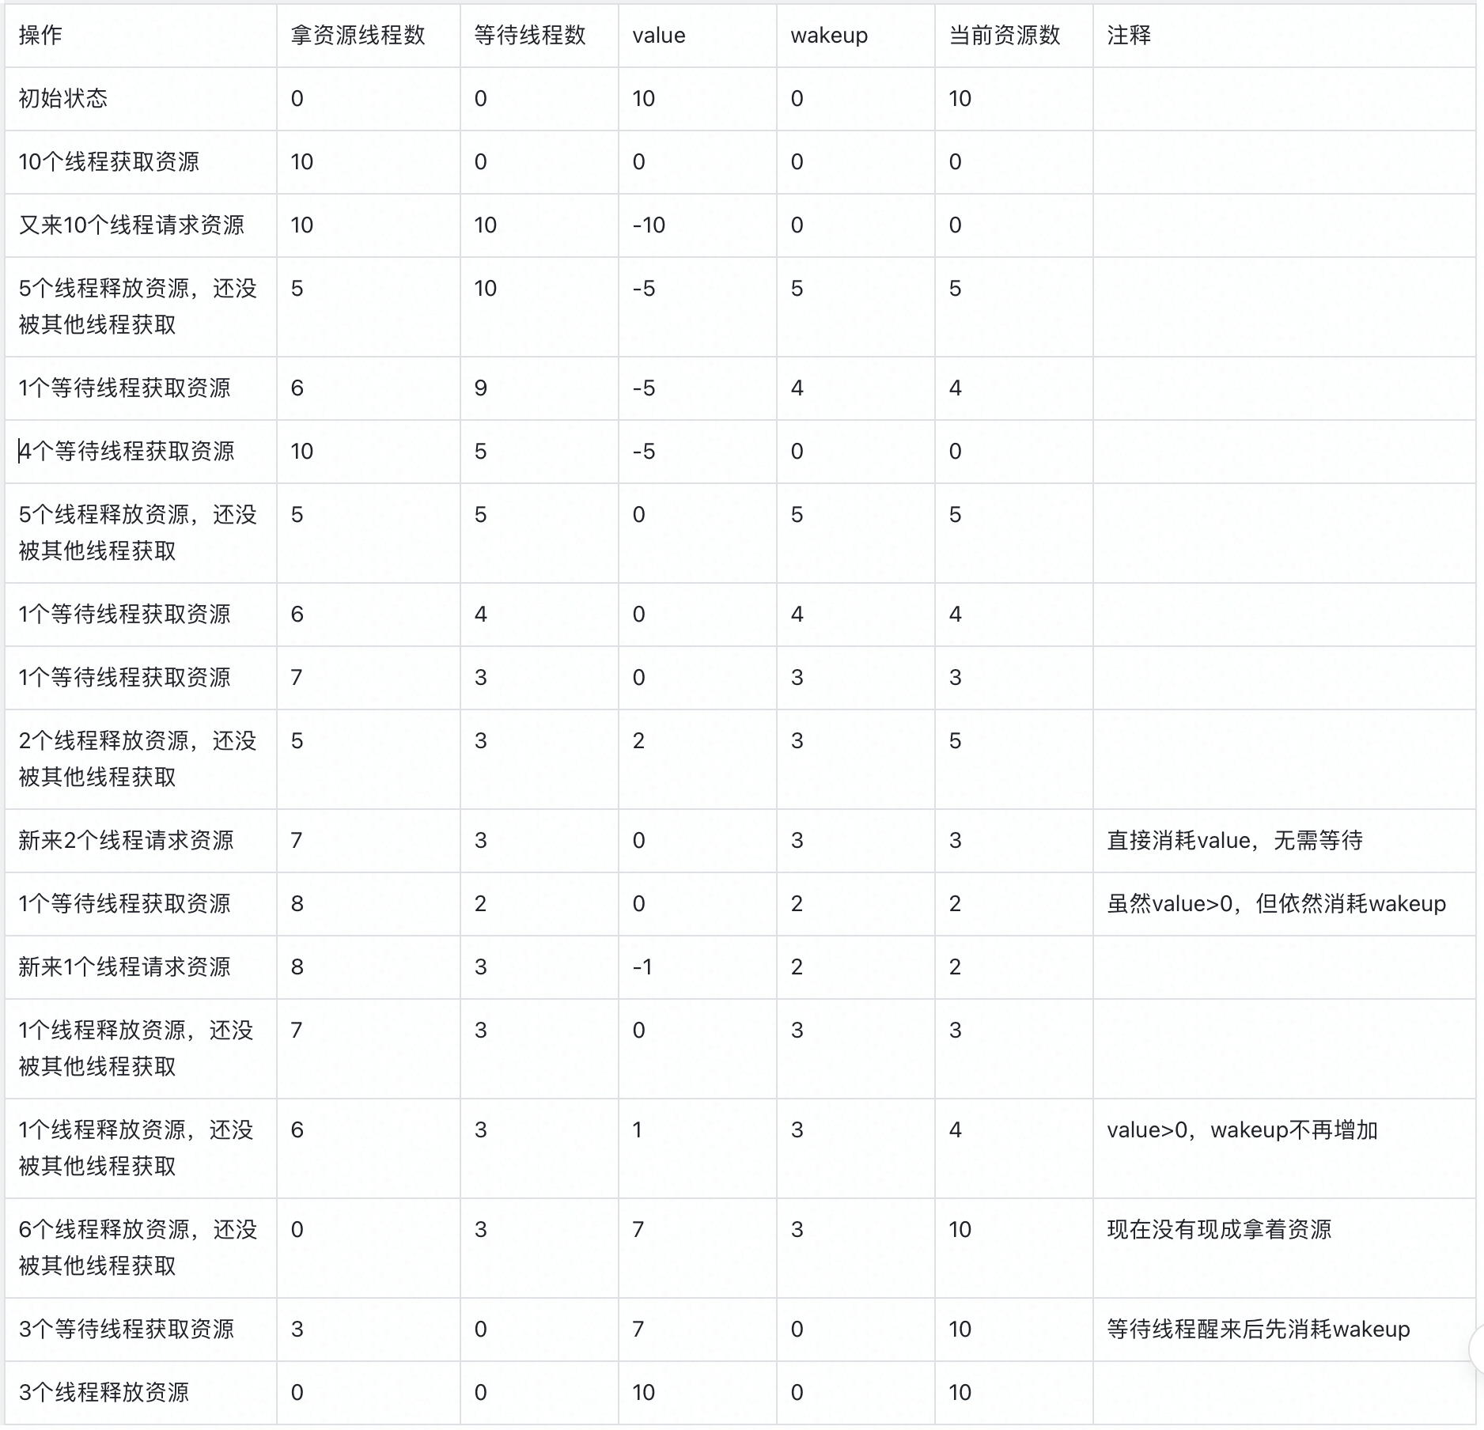

Slide 72
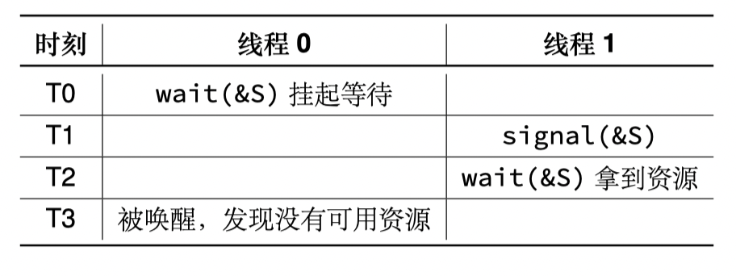
信号量的实现-4
介绍一种使用条件变量的实现：条件变量 + 互斥锁 + 计数器 = 信号量
value：正数为信号量，负数为有人等待 wakeup：等待时可以唤醒的数量
某一时刻真实的信号量：value > 0 ? value : wakeup
void wait(sem_t *S) {
lock(S->sem_lock);
S->value --;
if (S->value < 0) {
while (S->wakeup == 0){
cond_wait(S->sem_cond, S->sem_lock);
}
S->wakeup --;
}
unlock(S->sem_lock);
}
思考：为何要 while? 有限等待

Slide 73
读写锁的实现

Slide 74
回顾：读写锁的基础语义
互斥锁：所有的线程均互斥，同一时刻只能有一个线程进入临界区
对于部分只读取共享数据的线程过于严厉
读写锁：区分读者与写者，允许读者之间并行，读者与写者之间互斥
临界区
写者
读者
X
读者
读者可以进入临界区
写者不能进入临界区
*读/写临界区不同，这里指向一个为示意

Slide 75
回顾：读写锁的基础语义
互斥锁：所有的线程均互斥，同一时刻只能有一个线程进入临界区
对于部分只读取共享数据的线程过于严厉
读写锁：区分读者与写者，允许读者之间并行，读者与写者之间互斥
临界区
写者
读者
X
X
写者
读者不能进入临界区
写者不能进入临界区
*读/写临界区不同，这里指向一个为示意

Slide 76
读写锁的偏向性
考虑这种情况：
t0：有读者在临界区
t1：有新的写者在等待
t2：另一个读者能否进入临界区？
不能：偏向写者的读写锁
后序读者必须等待写者进入后才进入
能：偏向读者的读写锁
后序读者可以直接进入临界区
更加公平
更好的并行性

Slide 77
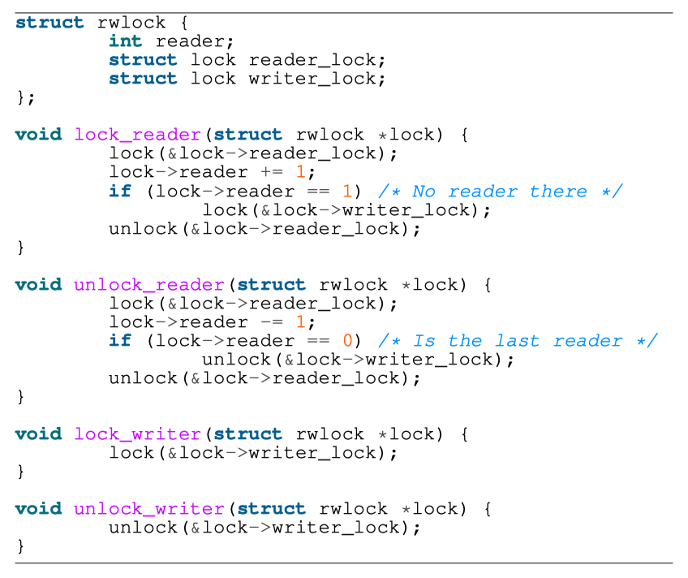
偏向读者 的读写锁 实现示例
Reader计数器：
表示有多少读者
第一个/最后一个reader负责获取/释放写锁
只有当完全没有读者时，写者才能进入临界区

Slide 78
读写锁的实现：偏向读者为例
读者锁
读者
临界区
获取读者锁，更新读计数器
如果没有读者在，拿写锁避免写者进入
释放读者锁
写者锁
0
读者计数器
在读临界区中的读者数量
*读/写临界区不同，这里指向一个为示意

Slide 79
读写锁的实现：偏向读者为例
读者锁
写者
临界区
读者
写者锁
尝试拿写锁，等待
1
读者计数器
在读临界区中的读者数量
*读/写临界区不同，这里指向一个为示意

Slide 80
读写锁的实现：偏向读者为例
读者锁
写者
临界区
读者
写者锁
读者
1
读者计数器
获取读者锁，更新读计数器
有读者在，无需再次获取写锁
释放读者锁
在读临界区中的读者数量
*读/写临界区不同，这里指向一个为示意

Slide 81
读写锁的实现：偏向读者为例
读者锁
写者
临界区
读者
写者锁
读者
2
读者计数器
在读临界区中的读者数量
*读/写临界区不同，这里指向一个为示意

Slide 82
读写锁的实现：偏向读者为例
读者锁
写者
临界区
写者锁
读者
读者
2
读者计数器
获取读者锁，减少计数器
还有其他读者在，无需释放写锁
释放读者锁
在读临界区中的读者数量
*读/写临界区不同，这里指向一个为示意

Slide 83
读写锁的实现：偏向读者为例
此时写者可以进入
读者锁
写者
临界区
写者锁
读者
1
读者计数器
获取读者锁，减少计数器
无其他读者在，释放写锁 ，写者进入临界区
释放读者锁
在读临界区中的读者数量
*读/写临界区不同，这里指向一个为示意

Slide 84
读写锁的实现：偏向读者为例
读者锁
临界区
读者
写者
写者锁
获取读者锁，更新读计数器
如果没有读者在，尝试拿写锁避免写者进入，等待。
0
读者计数器
在读临界区中的读者数量
*读/写临界区不同，这里指向一个为示意

Slide 85
读写锁的实现：偏向读者为例
读者锁
临界区
读者
写者
写者锁
读者
尝试拿读者锁，上面的读者还没释放，等待
1
读者计数器
注意：读者锁还有阻塞其他读者的语义， 因此不能用原子操作来替代
在读临界区中的读者数量
可以思考一下：如何实现偏向写者的读写锁？
*读/写临界区不同，这里指向一个为示意

